Slide 1
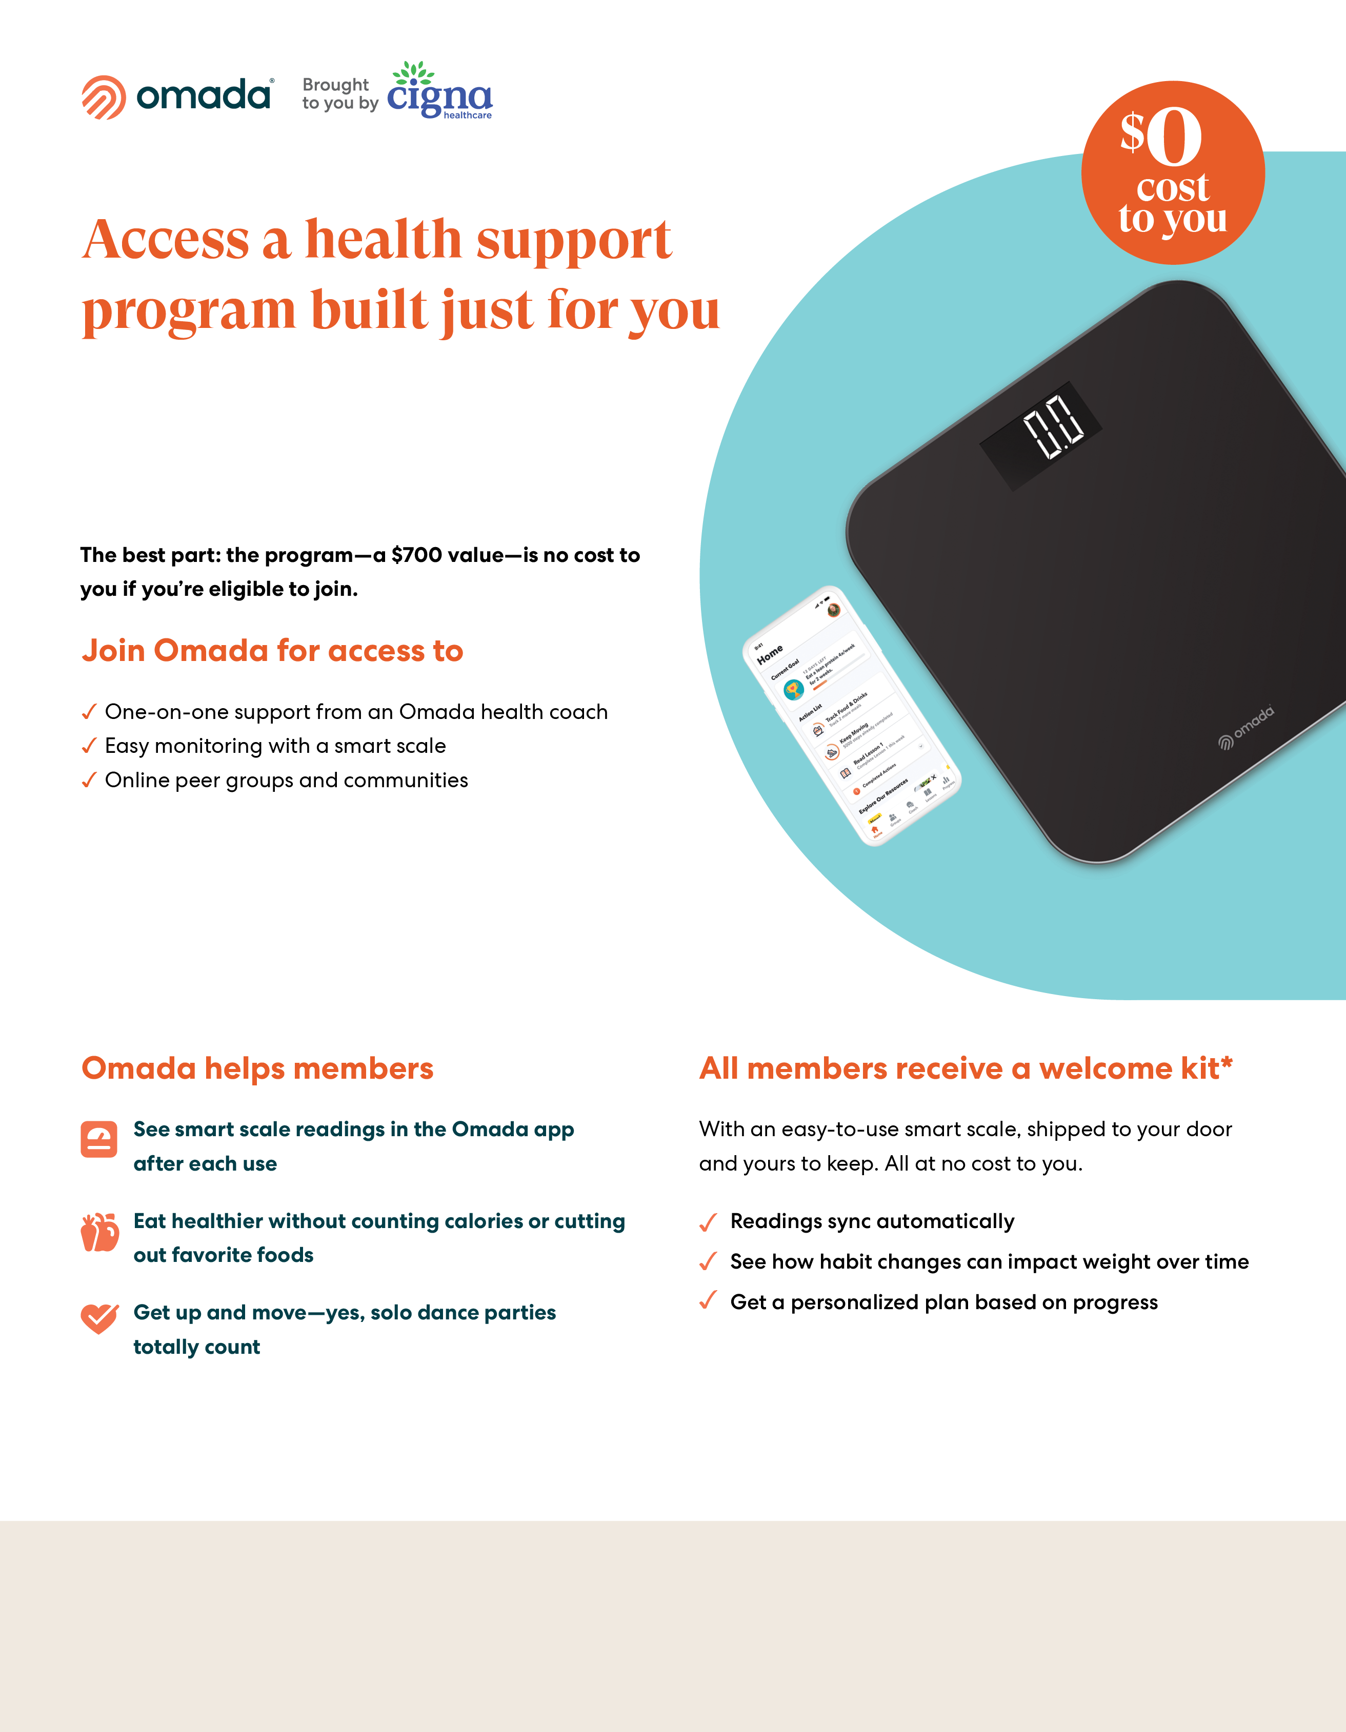
For eligible Cigna employees and their covered dependents
Cigna is offering Omada® to help members manage weight and create healthier habits with one-on-one personal coaching and the tools needed to make long- lasting health changes.
Register on the myCigna® website or app to receive additional information when Omada is open for applications
If you’ve already registered on the myCigna website or app, there is no need to re-register
If you or your covered adult dependents are enrolled in the company medical plan offered through Cigna, are at risk for type 2 diabetes or heart disease, and are accepted into the program, you’ll receive the program at no cost.
*Certain features and smart devices are only available if you meet program and clinical eligibility requirements.
Images, including apps, do not reflect real members or information about a specific person
The Omada® program is administered by Omada Health, Inc., an independent third party service provider. All Cigna Healthcare products and services are provided exclusively by or through operating subsidiaries of The Cigna Group or its affiliates. The Omada® program is not administered by Cigna Healthcare. It is administered solely by Omada Health, Inc. which is responsible for the program.

